Slide 1
ASYNC PROGRAMMING, REPOSITORY PATTERN AND AUTO-MAPPER

Slide 2
Async Programming
Asynchronous programming allows your application to start a time-consuming task (like talking to a database or downloading a file) and immediately move on to other work without waiting for that task to finish.
Why We Use It
Web APIs: It drastically increases scalability. One server can handle thousands of concurrent requests because threads aren't standing around "frozen" waiting for the database to reply.
Desktop/Mobile Apps: It keeps the application responsive. It prevents the screen from freezing or showing the "spinning wheel" while data is loading.

Slide 3
Repository pattern
The Core Concept The Repository Pattern creates a middleman (an abstraction layer) between your data access code (Entity Framework/SQL) and your business logic (Controllers). Instead of a controller digging into the database directly, it asks the "Repository" to go get the data for it.
Why We Use It
Separation of Concerns (Clean Code): Controllers should only care about receiving HTTP requests and returning HTTP responses. They shouldn't care how data is saved.
Easier Unit Testing: You can easily test your controllers by creating a "Fake" or "Mock" repository that just returns hardcoded lists instead of needing to spin up a real SQL server.
Swappable Data Sources: If your boss tells you to switch from SQL Server to MongoDB next year, you only have to write a new Repository. You don't have to rewrite a single line of code in your Controllers!

Slide 4
Automapper
AutoMapper is an "object-to-object mapper." It is a machine that takes an object of one type (like a database Region model) and automatically copies its data into a completely different object (like a RegionDTO for the user), as long as their property names match.
Why We Use It
Kills Boilerplate: It prevents you from having to write 50 lines of dto.FirstName = user.FirstName; every time you want to move data around.
Database Optimization: When paired with Entity Framework, you can use .ProjectTo<DTO>(). This translates your mapping directly into a highly efficient SQL SELECT query behind the scenes.
Security (Data Hiding): It makes it effortless to use DTOs (Data Transfer Objects) so you never accidentally expose sensitive database fields (like passwords or internal IDs) to the public API.

Slide 5
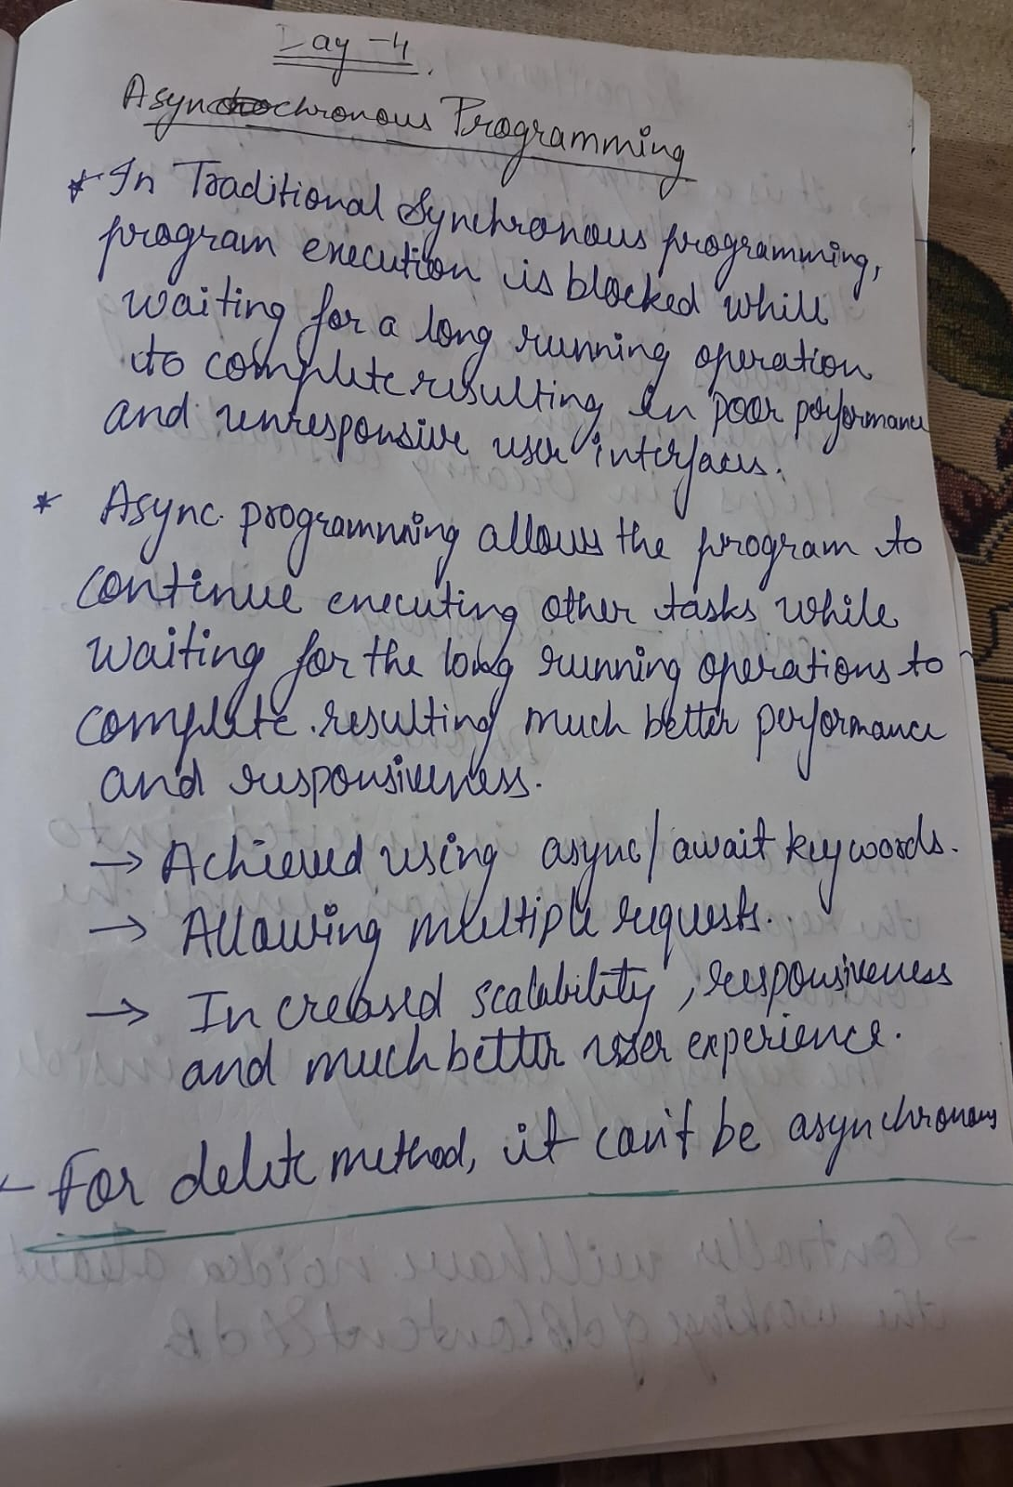

Slide 6
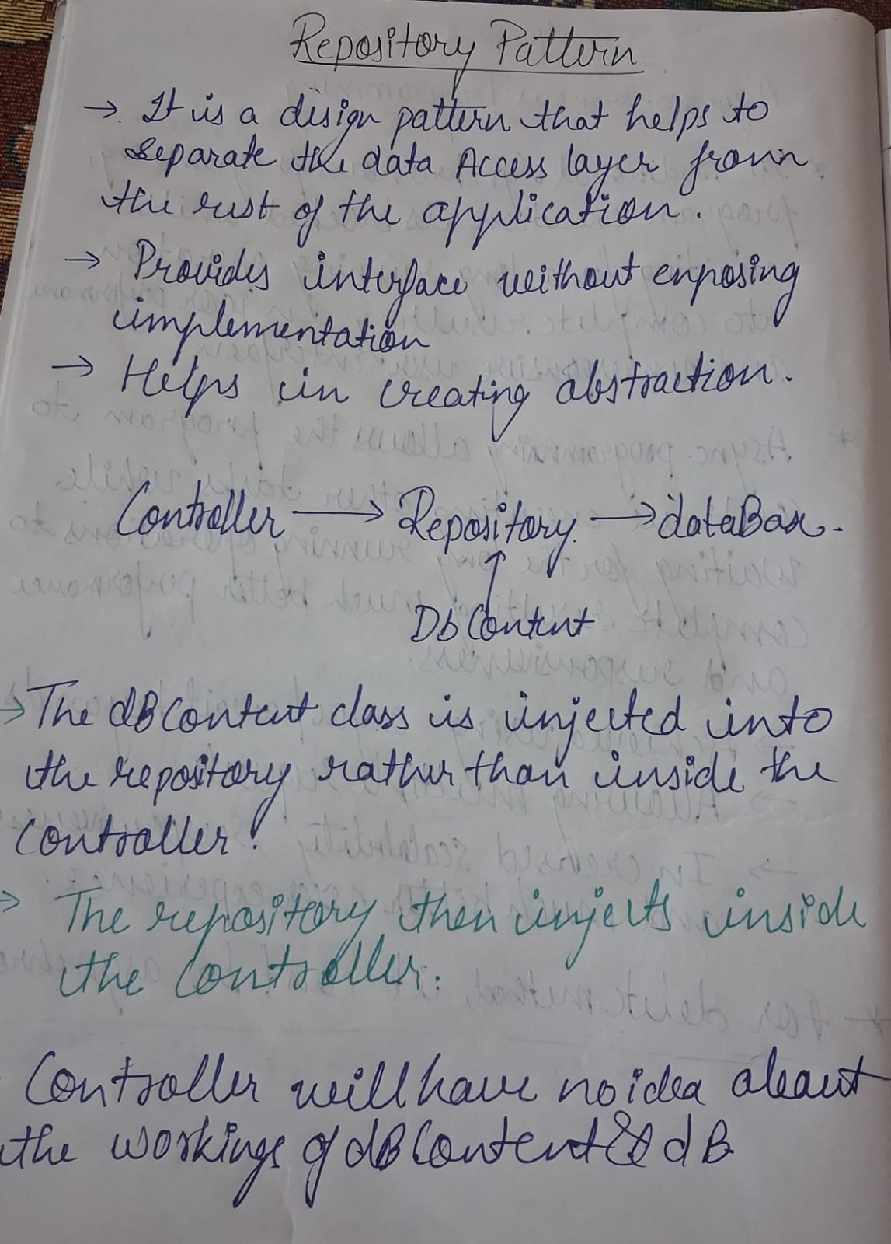

Slide 7
